Slide 1

Prototype Submission

Slide 2
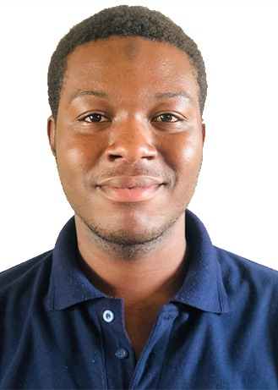
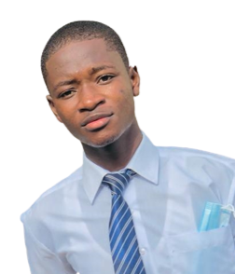
OUR TEAM THECODED_ecb4
Yussif Mohammed
Abdul-Gafur Saeed
THEME:
Innovative financial and transactional application
1

Slide 3

PROBLEM STATEMENT
During our empathy trip, the problem we found in Ghana here is the difficulty for people especially content creators (video creators, artists, writers, musicians, developers, gamers, and podcasters), students, start-ups, and people seeking financial help to get good funding due to how the financial system works in Ghana and Africa.
This results in stunting a lot of people dreams.
2

Slide 4
PROBLEM STATEMENT CONTINUED
A lot of people prefer easy Momo transactions as compared to bank and credit card transactions.
Fundraisers and supporters need a product that is meaningful and enjoyable to use, this meant designing a fundraising platform.
There are other fundraising or fun support platforms out there like goFundMe, Patreon, etc that have high positive reviews from users and experts, and how these platforms have impacted positively on users and generated much revenue, but none support Mobile money transactions or have the African content creators or fundraisers in mind.
3

Slide 5
SOLUTION
Explain, in brief, how you intend to SOLVE the problem at hand.
Please include the following:
How it helps to solve the problem?
What are the impact metrics that one can use to analyze the effect of the solution?
Frameworks/Tools/Technologies stacks to be used
Assumptions, constraints, and solution decision points (Reason behind choosing a technology)
How easily can your solution be implemented and how effective will it be?
Extent of Scalability/Usability

Slide 6
SOLUTION
This platform will enable fundraisers to provide the necessary details to request for funds or set up a fun base for their supporters to support them that will help them achieve their set goals and also give them the tools they need to capture and share their stories far and wide.
Since Mobile money transactions are one of the most widespread forms of transactions in Ghana and Africa at large with almost literates and illiterates using and learning every day to use mobile money transactions, this platform will give people a meaningful way to express gratitude to content creators, students, and fundraisers using a simple mobile money payment method and also help people receive financial support from their audience in a friendly manner with just a couple of taps.
This will increase financial inclusion thereby fostering economic development.
4

Slide 7
FRAMEWORKS/TOOLS/TECHNOLOGIES USED
Flutter (mobile framework)
Firebase (Backend As a Service)
Node js (Backend)
Paystack (Payment API with Mobile Money integration) for easy payment and transactions
5

Slide 8
ASSUMPTIONS AND CONSTRAINTS
Trust
App maintenance cost
Adaptation (working on multiple platform)
User Experience
SOLUTION
Trust maintenance using firebase for proper authentication and detection of face accounts
Commission for app maintenance (2% per transaction for students and 4% for content creators and others).
Flutter is used as the mobile framework since it gives space for multi-platform, thus the app can be viewed on the web, android OS, IOS, desktop and MacOS.
Momo API for easy funding and transactions.
6

Slide 9
PROJECT OBJECTIVES
Help fundraisers raise funds from patrons in an easy way
Remove complexity in raising funds
To share inspiration with everyone
Turn compassion into action
Share stories far and wide

Slide 10
HOW EASILY IT WILL BE IMPLEMENTED AND HOW IT WILL WORK
This platform will be widely used as a lot of students and fundraisers across the country need support to turn their dreams into reality.
This project will work by creating a platform where supporters will safely and easily send money to fundraisers and leave a short note behind. It is a way that content creators, students, fundraisers, and other professionals can make money from patrons.
The payouts will be processed immediately using MTN Momo within a couple of taps as mobile money transactions are widely used and preferred by most people.
7

Slide 11
METHODOLOGY
[ Include Concept, principles, elements and components. ]
Architecture Diagram
Flow Chart
Wireframes
Graphical representation
( Bar graph, Histogram, Pie charts, Heat maps)
Analysis, visualization
Please note: Upload the documents (eg: .pdf, .docx, .vsd etc) directly on the platform. However, the links can be inserted/attached in this PowerPoint template.

Slide 12
WORKING PROTOTYPE
[ attach Video, link for demo ]

Slide 13
Attachments
[ App wireframe, Screenshots, ]

